Slide 1
CSDP Open House
May 9, 2018
8:00am – 10:15am
Room 251-C, Cobo Center

Slide 2
Agenda
8:00 a.m. – 8:15 a.m.
Networking & Breakfast
8:15 a.m. – 8:25 a.m.
Welcome & Introductions – Brenda Marshall
8:25 a.m. – 9:55 a.m.
The State of D&I: Being a Change Agent to Move it Forward Doug Harris, CEO, The Kaleidoscope Group
9:55 a.m. – 10:05 a.m.
Reflections
10:05 a.m. – 10:10 a.m.
Technology Minute – Ken Doherty, Technology Committee
10:10 a.m. – 10:15 a.m.
Closing Remarks – Brenda Marshall

Slide 3
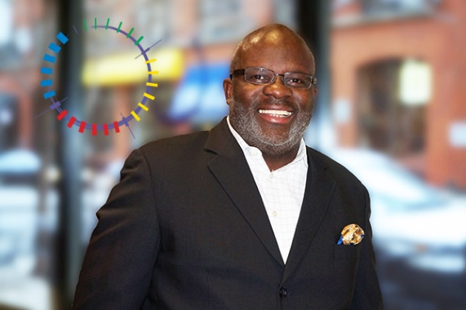
“I leave people better than I found them; and I do it with love.” -Doug Harris (CEO, The Kaleidoscope Group)
For almost 30 years, Doug Harris has impacted the American workplace with his work in Diversity & Inclusion (D&I). In fact, his work extends back far enough that he was a part of the movements and conversations that birthed and developed the industry that has grown from what was once
called “Affirmative Action: Next Phase”. Combining compassion and a keen business sense, he has shepherded organizations, teams and executives forward as the diversity dialogue has evolved from compliance, to fostering inclusion and, ultimately, achieving exceptional business outcomes.
Powerfully balancing the practical and the philosophical, Doug has partnered with countless clients to create customized strategies that address the specific diversity needs of each business and their unique company culture, working closely with leaders and executives to champion D&I, to develop commitment and enthusiasm across all employee groups. His energy and passion for the work have been described as “contagious” and few have walked away with anything less than an unforgettable experience.
“The new definition of power is empowering others.” -Doug Harris
The waves and ripples of his work have empowered organizations across this country and across sectors, from household names to small businesses, from financial institutions to academia, to make the absolute most of each of their people. As different as each of these organizations are, what they share is they have enriched their culture and advanced their mission by embracing Doug’s mission: To free the human potential ™.
“If you engage in self-development, you’ll be surprised how much better other people become.” -Doug Harris
To free the human potential. That, succinctly put, is what Doug has done for thousands upon thousands of people. He has helped them to free their own human potential and that of those around them. The impact of his work, his legacy, extends around the globe.

Slide 4
The Kaleidoscope Group, LLC is a full service diversity and inclusion (D&I) consulting firm. We are committed to providing customized strategic solutions to address the specific needs of an organization’s culture. We drive sustainable measurable results in the workforce, workplace, community, supplier base, and marketplace.
Founded in 1993,The Kaleidoscope Group is recognized among the top 10 pioneers in the D&I industry. Our clients trust us as a leader in the areas of D&I, cultural change, education and organizational development. We are a certified minority organization enterprise (MBE), headquartered in Chicago and we have an international presence.
The Kaleidoscope Group 416 W. Ontario Street, C-2 Chicago, IL 60654 info@kgdiversity.com kdgdiversity.com
312-274-9000

Slide 5
Profile Updates
Go to our website at www.ncsdp.com
At the upper right hand corner, enter your Email address and CSDP password to log in as a member.
Note: If you don’t know your password, click “Recover Password”. You will first be prompted for your email address (the one used for CSDP), and then your security word. For first timers, the question is typically “What color is the sky?” and the answer is ________. Asn an alternate, send an email to technology@ncsdp.com, and we will reset your password to a temporary one, and provide you with that. You’ll be prompted to update it upon signing in.

Slide 6
Profile Updates
Click on your name where it says “Signed in as XXXXXXXXX”

Slide 7
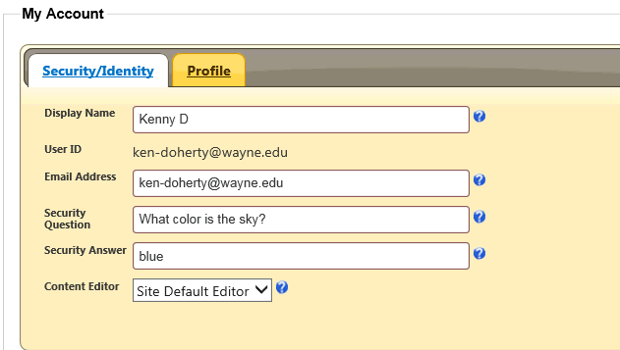
Profile Updates
Update as appropriate:
Under Identity / Security, you can update your
Display Name
Email address,
Security Question and Answer

Slide 8
Profile Updates
Update as appropriate:
Under Profile, you can update your
First and Last Name
Company Name
Occupation or Job Title,
Web Site URL (recommended to be your SD or Procurement Office)
Phone & Cell

Slide 9
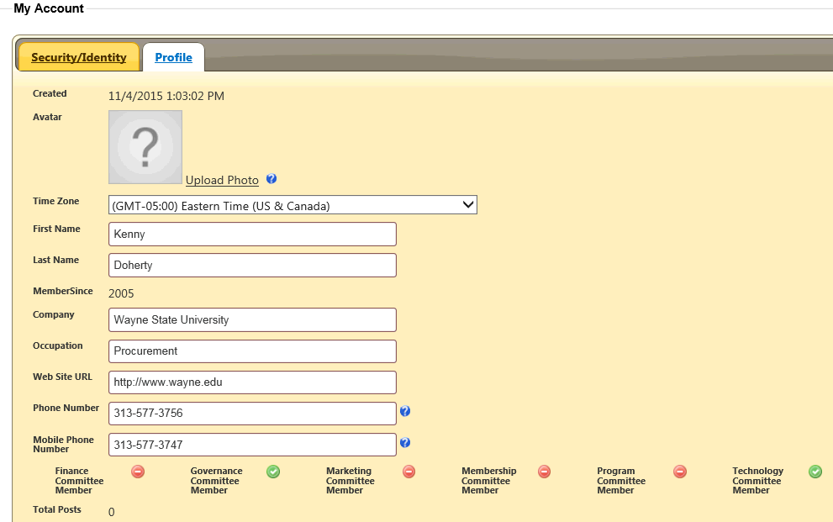
Profile Updates

Slide 10
Profile Updates
Things you will need to ask the Technology Committee to update if not correct include:
Under Identity / Security,
Your User ID (Generally matched to your email)
Under Profile,
Member Since (either by year of by date)
Committees in which you serve as a member

