Slide 1
CSDP Member Meeting
November 18th Membership Meeting

Slide 2
Agenda
8:30 a.m. – 9:00 a.m.
Networking
9:00 a.m. – 9:10 a.m.
Welcome & Introductions – Teresa LeFevre
9:10 a.m. – 9:35 a.m.
Kimberly Newberry-Johnson - DEVELOPING K.I.D.S.
9:35 a.m. - 10:45 a.m.
CSDP Elections – Eric Glenn
2023 Supplier Diversity Events Calendar - Teresa
10:45 a.m. - 11:00 a.m.
Faces of CSDP - Tina Alonzo & Art McClellan
CSDP Holiday Events Q&A
11:00 a.m.
Adjournment (CSDP Board of Directors Meeting Immediately Follows)

Slide 3
Board Elections - * Seats eligible for elections
Executive Board Positions | Name | Term (3 years)
President | Teresa LeFevre | 2022-2025
Vice Chair | Art McClelland | Appointed by chair
Secretary | Lillian Lowery | 2022-2025
Treasurer | Ken Doherty | 2020-2023*
Board Director positions | Name | Term (3 years)
Governance | Kenneth Gardner | Appointed by chair
Marketing | Courtney Quenneville | 2020-2023*
Membership | Lynn Garrison | 2020-2023*
Prog. / Prof. Development | Therissa Allen | 2020-2023*
Technology | Duane Green | 2020-2023*
Board Members-at-Large | Name | Term (1 year)
Special Projects | Brian Moore | Appointed 9/2022
Special Projects | Dan Muschong | Appointed 9/2022

Slide 4
2023 CSDP Meeting Calendar
Date | Time | Event Title | Location
01/27/23 | 8:30am - 11:30am | CSDP Annual Meeting (Board Meeting follows)
03/24/23 | 8:30am - 11:30am | CSDP Meeting (Board Meeting follows)
05/26/23 | 8:00am - 10:15am | CSDP Meeting (Board Meeting follows)
07/28/23 | 8:30am - 11:10am | CSDP Meeting (Board Meeting follows)
09/22/23 | 8:30am - 11:30am | CSDP Meeting (Board Meeting follows)
11/17/23 | 8:30am - 11:30am | CSDP Meeting (Board Meeting follows)
Dec TBD | TBD | CSDP Holiday/Community Service

Slide 5
1Q 2023 Events
Date | Time | Event Title | Location | Purpose
Feb TBD | 5pm-6pm | MHCC Membership meeting | Virtual | Membership information
03/09/23 | 9:00am -1:00pm | APACC East Meets West Business Connections | Walsh College, Troy, MI | Networking, "Meet the Buyers"
TBD ? | 11:00am - 5:00pm | NAWBO Top 10 MI Business Women Awards | Virtual | Awards Celebration
TBD ? | 9:00am - 12:00pm | Great Lakes WBC - ExecWE | Virtual | training, networking
03/20/23 | All Day | WE Connect International Day | Nashville, TN | alongside WBENC, seminars, networking
3/20/23-3/23/23 | All day | Women's Business Enterprise National Council Annual Conference and Trade Fair | Gaylord Opryland Resort, Nashville, TN | 26th WBENC, expo, matchmaking
TBD ? | 7:30am-10am | 18th Annual MHCC Economic Forum Breakfast | Detroit Athletic Club | Networking

Slide 6
2Q 2023 Events
Date | Time | Event Title | Location | Purpose
4/11/23 - 4/12/23 | All Day | Pacific Southwest MSDC Procurement Conference | Phoenix, AZ | conference, trade show, networking matchmaking
TBD ? | 10:00am - 4:00pm | Detroit Regional LGBT Chamber Spring Summit |  | Conference, matchmaking, networking
TBD ? |  | Great Lakes WBC - Annual Awards Celebration | Suburban Collection, Novi | Awards Celebration
04/29/23 | 6:00pm - 12:00am | APACC Annual Gala | MGM Grand, Detroit | Awards, Networking
5/1/23 - 5/2/23 | All Day | ACCESS Conference and Trade Show (D/FW MSDC) | Virtual Meeting | conference, networking and diversity training events
5/2/23 - 5/4/23 | All day | Michigan Minority Procurement Conference | Huntington Place, Detroit | trade fair, networking matchmaking, seminars
5/3/23 - 5/4/23 | All day | WE Connect International Gala and Global Symposium | Washington, DC | Gala on 5/3; Symposium on 5/4
May TBD | All Day | MHCC Annual Supplier Diversity Matchmaker |  | Networking, mini-trade fair
June TBD | 6:00pm - 10:00pm | Detroit Regional LGBT Chamber Pride Awards Gala | Motor City Grand Ballroom | awards gala, networking

Slide 7
3Q 2023 Events
Date | Time | Event Title | Location | Purpose
07/10/23 | All Day | MMSDC Golf Tournament | Oakland University | Networking
7/10/23 - 7/13/23 | All Day | Disability:IN | Orlando, FL | trade fair and conference, networking and training
7/11/23 - 7/13/23 | All day | NMSDC Supplier Diversity Manager's Training Seminar | TBD | Training for SDD managers
Aug TBD | All Day | NVBDC - Federal Reserve Conference |  | Matchmaking, networking
8/14/23 - 8/18/23 | All Day | NGLCC International Business & Leadership Conference | Hyatt Regency, Denver, CO | Expo, Matchmaking
Aug TBD | 5:00pm - 8:00pm | APACC Blood of the Dragon |  | Networking
Aug TBD | All Day | MHCC Golf Outing |  | networking
Sept TBD | All Day | BMW
Sept TBD | 9:00am-3:00pm | Stellantis Matchmaker | Tech Center, Auburn Hills | networking/trade fair
Sept TBD | All day | 20th Annual Great Lakes WBC Conference | Suburban Collection | Trade fair, meet the buyer, seminars

Slide 8
4Q 2023 Events
Date | Time | Event Title | Location | Purpose
October TBD | 4:30 - 8:30pm | MMSDC Annual ACE Awards & Chairman's Gala | Suburban Collection, Novi, MI | Awards ceremony, networking
TBD | 12:00pm - 4:00pm EST | Toyota Matchmaker | Suburban Collection, Novi, MI | trade fair, training seminars, networking
10/18/23 | All DAy | WE Connect International Canada Conference | Toronto, Canada
10/22/23 - 10/25/23 | All Day | NMSDC Conference & Trade Fair | Baltimore, MD | Trade fair, training seminars, networking and committee/board meetings
TBD | All Day | 14th Annual NVDBC Vets Business Matchmaking | Grand Rapids, MI | Trade Fair, Matchmaker, Networking
11/18/22 | 5-8pm | D/FW MSDC Annual Awards Dinner | Dallas, TX | Awards Celebration, Networking
Dec TBD | 6:00 - 11:00pm | MHCC Fiesta Hispana Gala | MGM Grand, Detroit

Slide 9
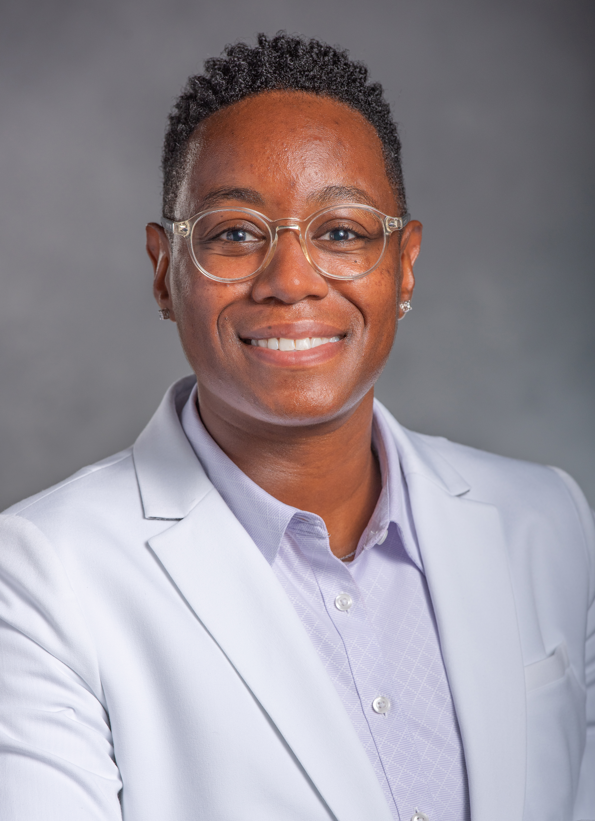
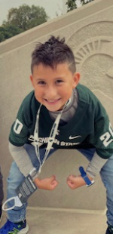
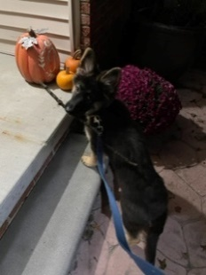
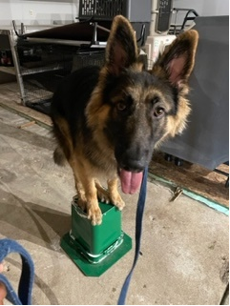
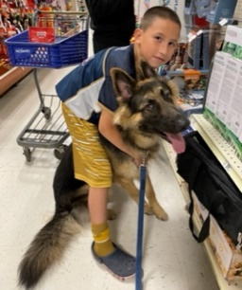
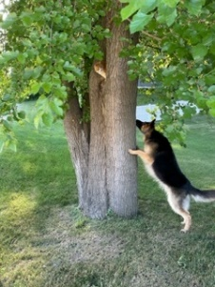
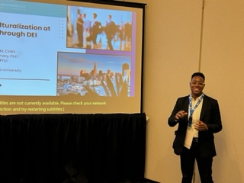
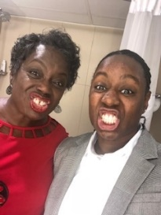
Tina Alonzo,
My remote office photo…
A little about me…
Fun Fact…
Spare Time…
EVPA DEI Administrator
Professionally speaking…
Quotes that I believe in…
MIDC Advisory Board Member
Certifications and Certificates
DEI Consulting
Awards and Recognition
“I never lose. Either I win or I learn.” – Nelson Mandela
--
“There is only one way to see things until someone shows us how to look at them with different eyes.” - Pablo Picasso
Influences in my life…

Slide 10
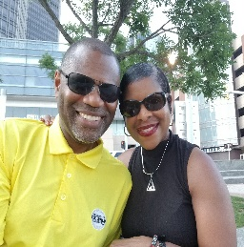
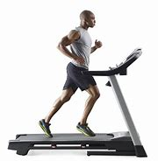
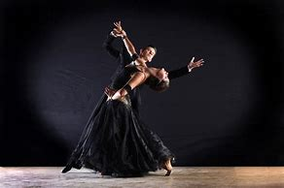
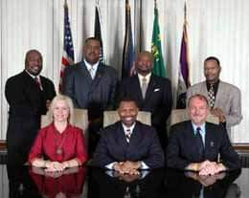
Art McClellan Director of Supplier Diversity
My remote office photo…
A little about me…
Fun Fact…
Your Photo Here
Insert personal photos or text – family, hobbies, etc
Personal or professional
Professionally speaking…
Spare Time…
Title
Vice Chair
Board of Directors
COECP – Exec. Coach
Moderator – PM
Speaker - JumpStart
Quote or phrase that I believe in…
Board of Directors
Co-Chair - CDC
InFuse Mentor
Moderator – MMPC
Panel Speaker
Panel Speaker
“The role of a leader is not to come up with all the great ideas. The role of a leader is to create an environment in which great ideas can happen” – Simon Sinek
Influences in my life…
Insert photos or text here
Pontiac
Alumni
Foundation

